Slide 1
RepoAgent
Streamlining Your Documentation Workflow Like Never Before
-- Qinyu (“Logic”) Luo Nov. 2024
Email: qinyuluo123@gmail.com
qluo8@jh.edu
Notes:
goal is to reconstruct the entire documentation generation workflow

Slide 2
The story starts from XAgent
https://github.com/OpenBMB/XAgent/

Slide 3
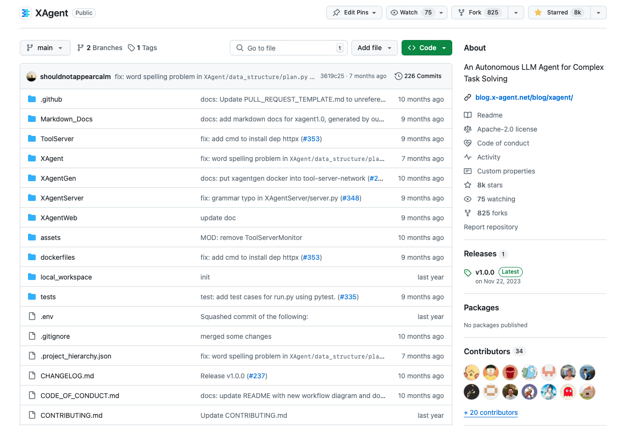
Notes:
we found that as the codebase grew larger and more people joined the project, it became increasingly difficult to manage. This was particularly challenging for many newcomers, who struggled to quickly integrate into the project due to its complex codebase and structure, as well as the numerous new concepts and definitions that were not clearly understood.
This led to an urgent need for good documentation to help newcomers onboard. However, our laboratory at Tsinghua University was already short-staffed, with fewer than 20 people, and each member was among the top in their respective fields in China. As a result, no one wanted to focus on writing documentation; everyone preferred to contribute algorithms, ideas, or code. This created a stalemate.

Slide 4
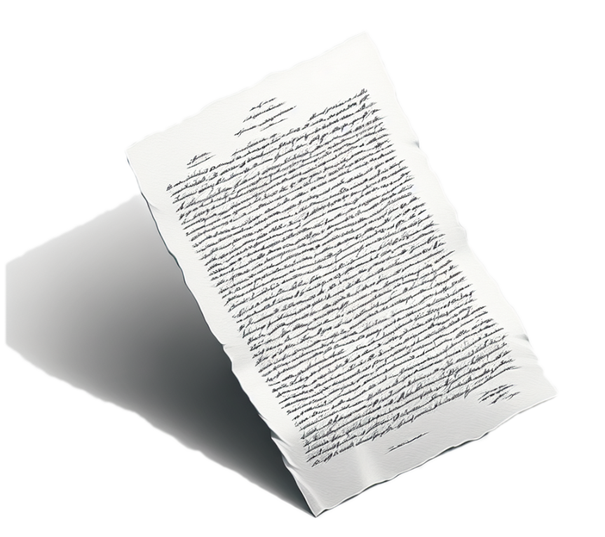
Documentation Engineer
It’s hard work but super important...
Creating, Managing, and Maintaining technical documentation...
Collaborate with product managers, developers, and other team members
Notes:
This experience also marked the first time we realized that documentation engineering is a formal profession. In many large companies, such as Google, Amazon, Microsoft, and Apple, they have dedicated documentation engineers who work closely with the entire team to manage and maintain all technical documentation.

Slide 5
Can we build an AI Document Engineer ?
Notes:
We then started to think, since we are researching AI, could we build an AI tool to take on the role of a documentation engineer?

Slide 6
Goals
Clarity and Simplicity
Accuracy and Consistency
Auto Maintaining and Sychronizing
Well Structured
Easy to Understand (Examples)
Easy to Retrieve
Global Perception
... ...
Notes:
So we set a goal for our tool: we hope it can truly address the challenges that newcomers face when joining the X-Agent project. We broke this down into smaller objectives. For instance, we want the generated documentation to be clear, simple, and accurate, while maintaining consistency. Additionally, I don’t want the documentation to become a burden, so I hope this tool can automatically maintain and synchronize the documentation among all writers in the project.
I also hope that the document structure will be very clear and well-structured, making it easy for even beginners to understand. it should have a global perspective, enabling users to understand what the entire project is doing and providing suitable macro-level guidance.

Slide 7
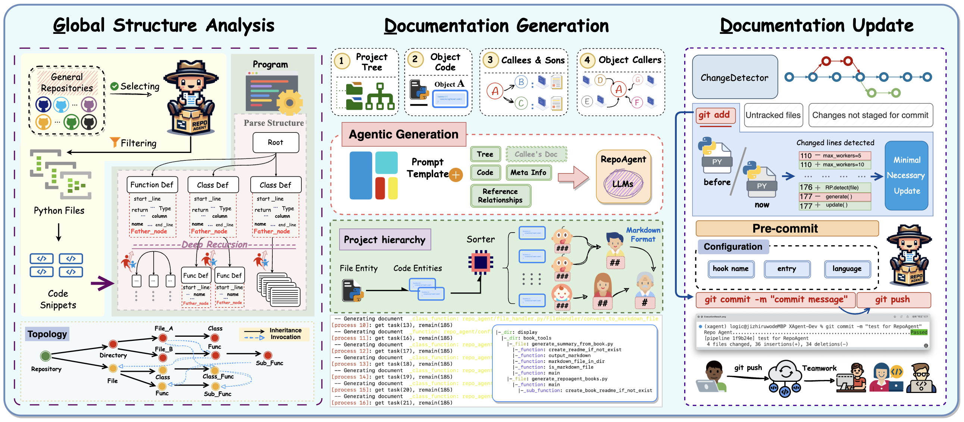
Methodology
Notes:
Our approach consists of three main components: global structure analysis, document generation, and automatic document maintenance and updating.

Slide 8
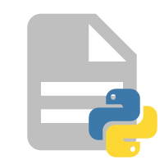
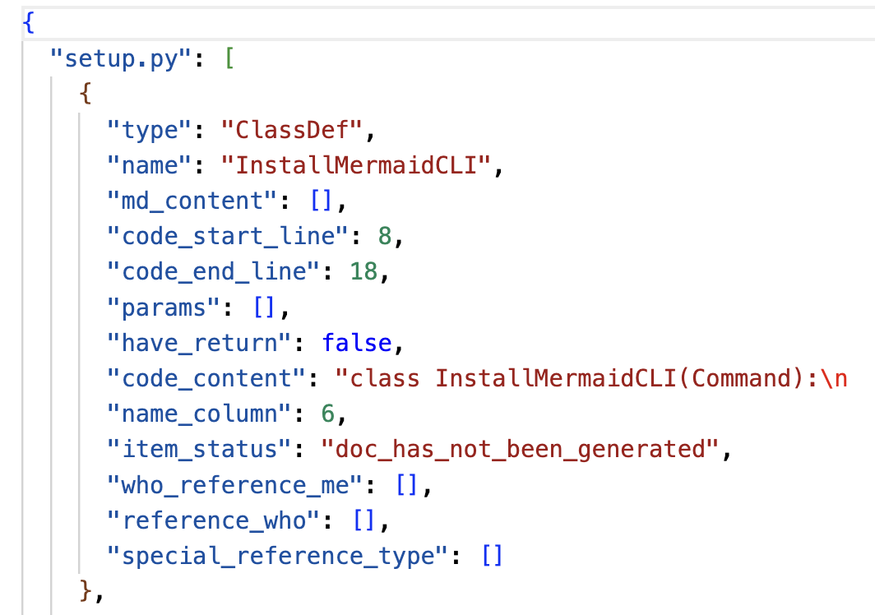
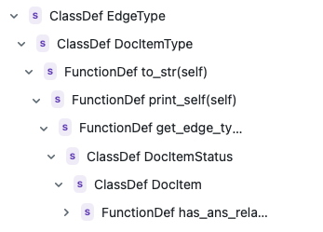
Breakdown Structure
Repository-level && AST-walk
Code Snippets
GitignoreChecker
Also can configure
ignore_list = [ ]
Notes:
First, for the global structure analysis, we break down the entire project and all associated GitHub repositories into different files and folders, identifying hierarchical relationships. We also configured settings that allow us to automatically ignore files that do not require documentation based on user needs. For each piece of code, we generate meta-information, which records relevant elements of the code file, such as its type, name, starting line, and more. With this data, we can construct a comprehensive global architecture.

Slide 9
Global bi-directional callee & callers
https://jedi.readthedocs.io/en/latest/
This is great, but we can only get one direction (script.get_references)...
In this way, we have to parse the whole project to get “who I referenced” and record it in the global project_hierarchy
Notes:
Next, we developed a bidirectional referencing algorithm. We utilized a library called Jeddy, which is excellent but can only obtain on direction references. Therefore, we had to combine it with our previously parsed meta data to establish the original information about which entities reference which others, recording this data in the meta-information. The first two steps involve parsing the project tree, file structure, code, hierarchical relationships, and call relationships.

Slide 10
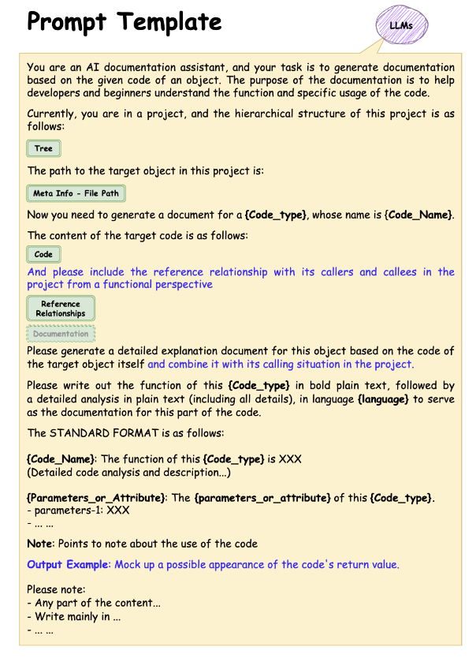
Project Tree
File hierarchy
Object Meta Information
Code
Bi-directional
relationship
Related former code docs
What if length exceed or other error...
Auto model switching
Auto info shrinking
Exception handling and retry method
Summarizing
Chunking
......
Notes:
After parsing the hierarchical and call relationships, we move on to document generation. We have developed our own prompt structure, which includes the meta-information extracted earlier. This might include the current object’s position in the overall project tree, its hierarchical architecture, its specific metadata, and the details of its code, including bidirectional references—who it references and who references it—and whether it has sub-nodes. If there are sub-nodes, we generate their documentation first and integrate that content into the main document.
If we encounter an object whose content is too lengthy exceeding the model context limitation, we have methods to automatically switch models and reduce the associated information based on a priority sequence. Additionally, we can also leverage mechanisms such as summarizing and chunking functions to reduce the length.

Slide 11
Topology Generation
task_available_func will ensure that the tasks of the dependent objects have been identified and processed before adding the tasks of this object.
We make sure leaf node should be generated at first. This is helpful if users want more accurate and relavent results by putting callers/callees documentation into the perception.
Notes:
During the generation process, we follow a sequence based on a Topology structure. The various scenarios depicted in the diagram represent situations commonly encountered in code projects.
The first two types are quite normal; they represent a tree structure or a network structure. We start by generating documentation for all the leaf nodes first and then move upwards to generate the parent nodes, following this path upward. However, for the circular graph on the far right, it involves circular references—sometimes even self-references—which can lead to infinite loops. In such cases, we skip these nodes, as they typically represent bugs in the code.

Slide 12
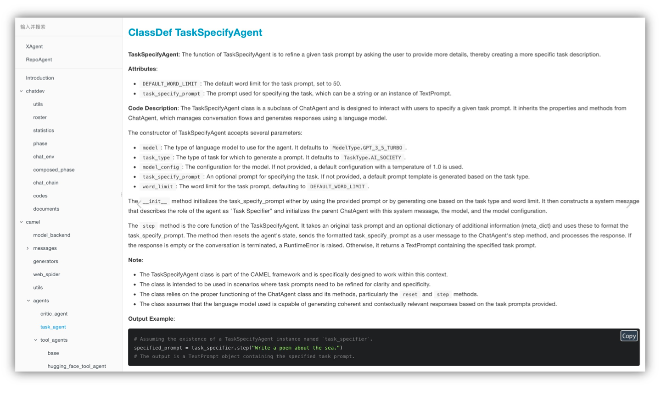
click delay for diff parts red box
Notes:
The final generated documentation is structured as follows:

Slide 13
click delay for diff parts red box
Notes:
The final generated documentation is structured as follows:

Slide 14
click delay for diff parts red box
Notes:
The final generated documentation is structured as follows:

Slide 15
click delay for diff parts red box
Notes:
The final generated documentation is structured as follows:

Slide 16
click delay for diff parts red box
Notes:
The final generated documentation is structured as follows:

Slide 17
click delay for diff parts red box
Notes:
The final generated documentation is structured as follows:

Slide 18
click delay for diff parts red box
Notes:
The final generated documentation is structured as follows:

Slide 19
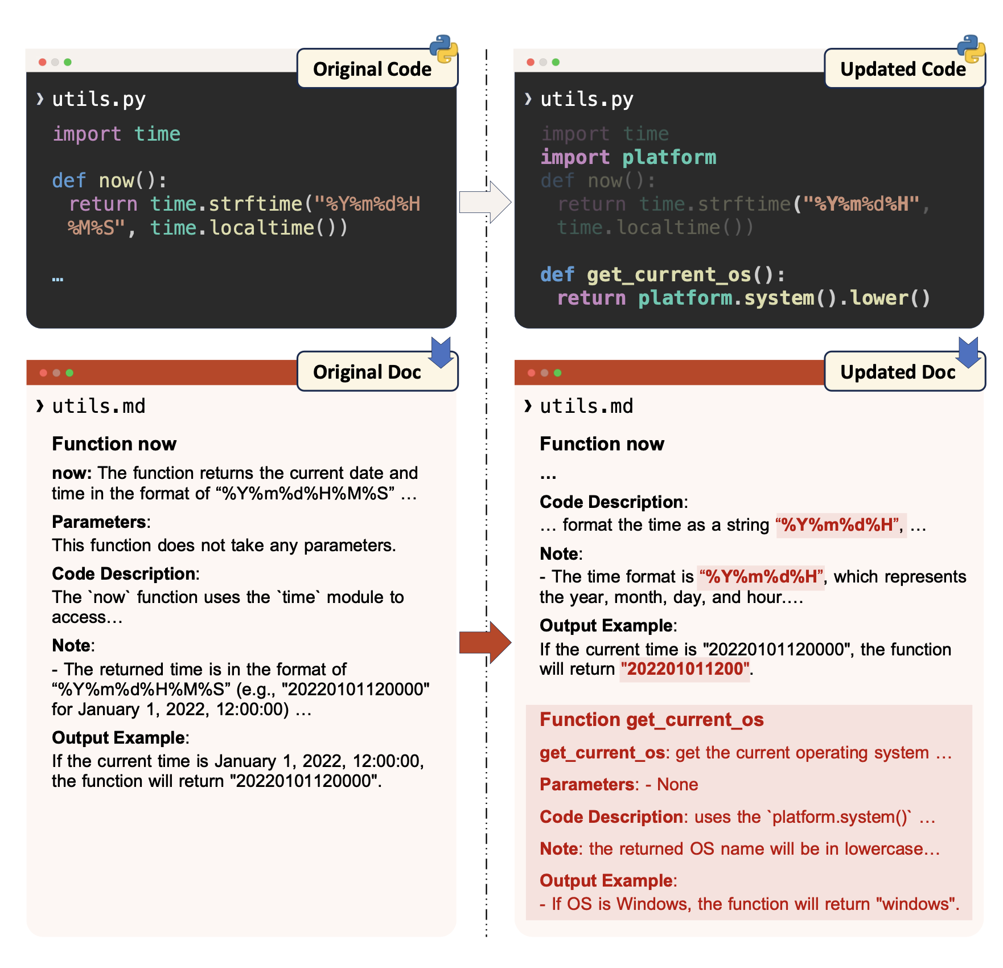
Markdown Documentation
Minimize the necessity to update -- keep consistency
We designed RepoAgent to makes the Documentation like a book in mark down format
Notes:
1. One-Line Description: A brief summary of the current object, providing a concise introduction.
2. Attributes and Corresponding Descriptions: Detailed information about the object’s attributes and their explanations.
3. Code Logic and Algorithm Explanation: A section that explains the logic behind the code and any algorithms used.
4. Important Considerations: Notes that provide developers with reminders or warnings about potential pitfalls.
5. Output Examples: If the object produces output, this section includes examples that help developers better understand their implementation.

Slide 20
Detect changes and auto update
Notes:
After the document generation, the next steps involve automatic detection of changes and the automatic maintenance of the documentation.

Slide 21
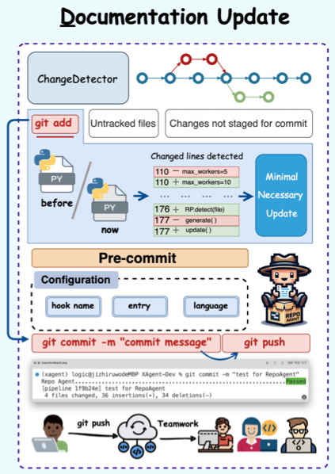
At first we use only git to detect change
We build “fake files” to ensure he documentation generation process uses the latest code changes without affecting the actual working directory state.
Avoids possible errors and human negligence.
Addresses various edge cases.
Utilizes the idea of merging
Notes:
Initially, we used Git to detect changes, but this approach encountered various potential errors and human oversights, such as forgetting to commit changes or edge cases. As a result, we adopted a new approach using the idea of merging, where we created fake files to ensure that the entire production process is always compared against the latest version.

Slide 22
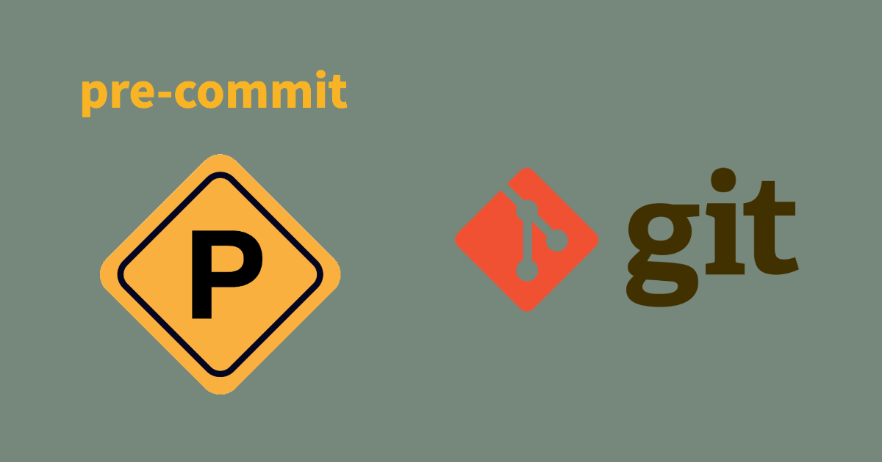
Auto Maintaining
RepoAgent fully complies with the original development process and habits
Coding
Git add
Git commit
Git push
Auto commit by RepoAgent
New code version
New doc version
simultanously update for one version
Notes:
RepoAgent’s automatic maintenance feature fully adheres to the original development workflow and human habits. From coding to Git Add, Git Commit, and Git Push, the generated documentation is automatically committed by RepoAgent. Thus, every commit represents a new version of the code and the documentation as a unified whole, ensuring consistency between the code and the corresponding documentation.

Slide 23
Evaluations

Slide 24
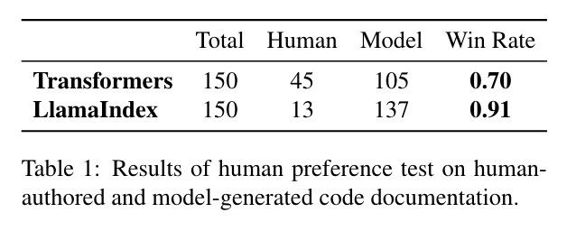
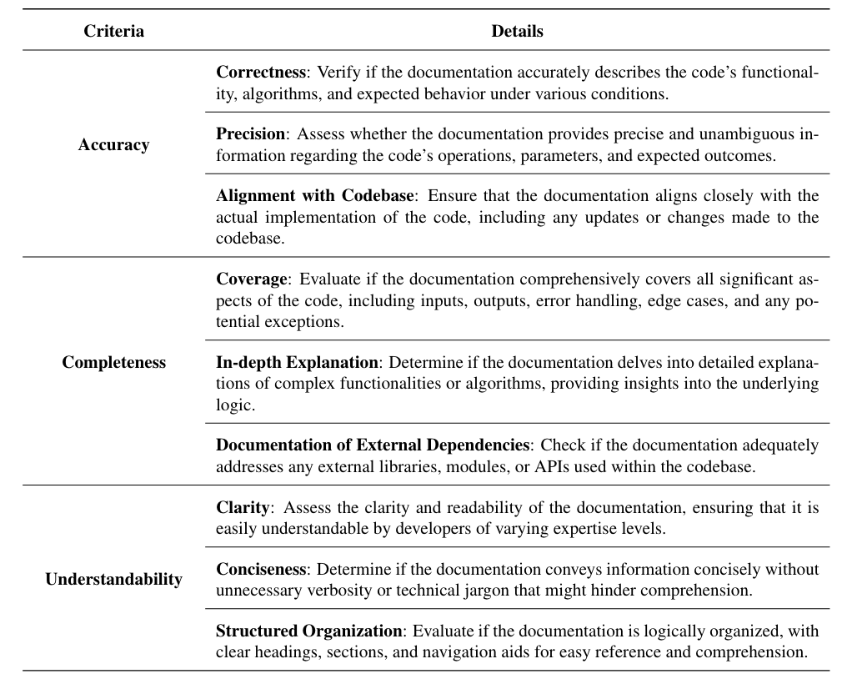
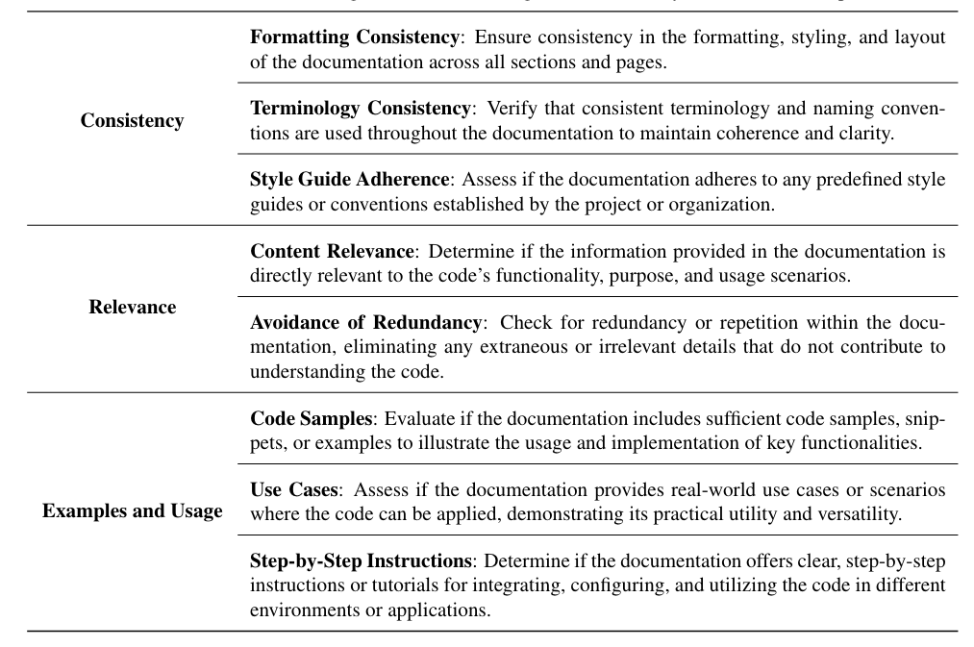
Human evaluation result
Evaluation criteria
Notes:
In the evaluation phase, we conducted human assessments by generating documentation for two representative repositories, Transformers and Lama Index, using RepoAgent. We then employed human annotators to perform blind tests to determine which documentation was better. The results showed that RepoAgent achieved a 70% win rate on the Transformers repository and a 91% win rate on the Lama Index.
Also we ensure the annotators followed specific guidelines to maintain consistency and objectivity during the human assessment process.

Slide 25
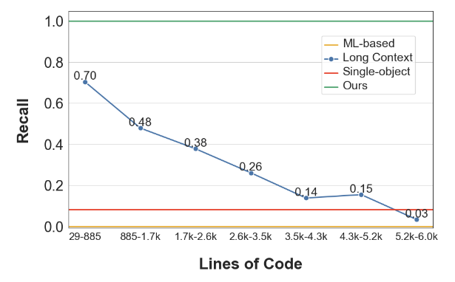
Reference Recall
ML-based method.traditional machine learning and deep learning methods for generating comments
Long context concatenation. directly concatenates the code snippets until the context length reaches 128k to let the model discover reference relationships.
Single-object generation. method using LM to generate documentation by directly feeding code snippets of the target object.
Notes:
In the reference recall experiment, we tested four different methods. Among these, the single-file generation and machine learning approaches were unable to detect references across the entire repository, meaning they lack global preception. Another approach involves using long context, where as much code as possible is fed into the model. However, this method not only consumes a large number of tokens but also tends to forget many reference relationships as the context length increases. Compared to our method, this approach has significant disadvantages.

Slide 26
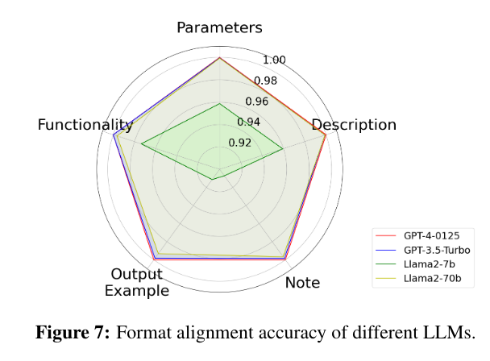
Format alignment
Can (open-sourced) language model do that?
Adherence to the format is critical in documentation generation. For certain style or consistency
Entire 5 basis sections
Exactly the same name and format
Can be parsed as markdown as required
from 92% to 100% accuracy on 9 repositories... they are relatively good
Notes:
In the Format Alignment experiment, we were particularly curious about whether open-source models could maintain the required consistency in documentation. We divided the evaluation into five dimensions as mentioned earlier. We aimed to assess the models’ ability to achieve format alignment across these five dimensions, including their capability to generate files that can be parsed into the required Markdown format.
According to the experimental results, even the relatively weaker open-source models achieved a 92% accuracy rate. While not perfect, this is still a fairly good performance in maintaining format consistency.`

Slide 27
Parameter Identification
Note: we were calculating accuracy here, not recall.
Accurately identifying and describing parameters or attributes in code is crucial as it helps readers quickly understand the design logic and usage.
Because of hallucination !! generating nonexistent parameters or wrong affiliations
a box help to focus over there
Also containing format following ability*
Notes:
In the Parameter Identification experiment, we focused on measuring the accuracy of the parameters provided in the output rather than the recall rate. Accurately describing and identifying parameters in the code is crucial, as it helps readers quickly understand the overall design logic.
However, we found that, in many cases, even the best models tend to hallucinate, often generating nonexistent parameters or incorrectly attributing parameters to the wrong levels. Some models would invent parameters based on the code logic, leading to inaccuracies in the documentation. In this experiment, we specifically tested their capabilities in this regard.
in this scenario, we stiil did not train the models, so I believe this situation is partly related to the models’ inherent capabilities and partly indicates areas that require training to improve their performance. Enhancing training processes could help address these issues and boost accuracy in parameter identification.

Slide 28
One more thing...
Chat with Repo

Slide 29
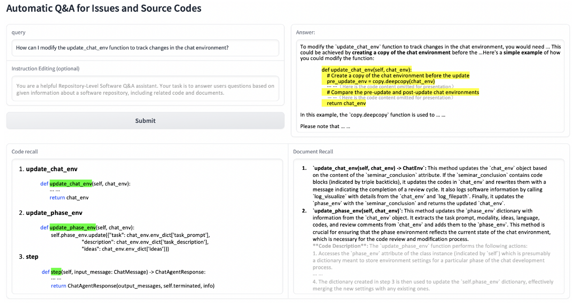
Notes:
The "Chat with REPL" module builds on the foundational documentation features of REPLIGION. Our goal is to further simplify developers' workflows and save them time. For instance, when they have a question, they don’t need to search through the documentation themselves; they can directly ask the large language model to receive a well-informed response.
For example, if I want to know the functionality of a specific function or how to implement a new function, the documentation generated by REPLIGION has a global perspective and can relate different documents to each other. This capability allows it to generate comprehensive and accurate answers.

Slide 30
Notes:
The "Chat with REPL" module builds on the foundational documentation features of REPLIGION. Our goal is to further simplify developers' workflows and save them time. For instance, when they have a question, they don’t need to search through the documentation themselves; they can directly ask the large language model to receive a well-informed response.
For example, if I want to know the functionality of a specific function or how to implement a new function, the documentation generated by REPLIGION has a global perspective and can relate different documents to each other. This capability allows it to generate comprehensive and accurate answers.

Slide 31
Notes:
The "Chat with REPL" module builds on the foundational documentation features of REPLIGION. Our goal is to further simplify developers' workflows and save them time. For instance, when they have a question, they don’t need to search through the documentation themselves; they can directly ask the large language model to receive a well-informed response.
For example, if I want to know the functionality of a specific function or how to implement a new function, the documentation generated by REPLIGION has a global perspective and can relate different documents to each other. This capability allows it to generate comprehensive and accurate answers.

Slide 32
Notes:
The "Chat with REPL" module builds on the foundational documentation features of REPLIGION. Our goal is to further simplify developers' workflows and save them time. For instance, when they have a question, they don’t need to search through the documentation themselves; they can directly ask the large language model to receive a well-informed response.
For example, if I want to know the functionality of a specific function or how to implement a new function, the documentation generated by REPLIGION has a global perspective and can relate different documents to each other. This capability allows it to generate comprehensive and accurate answers.

Slide 33
similarity search
do not align well
Natural language
Code
“COT”
Semantic Bridge
Redirect
similarity search
Exact match
ES search
Natural language
Document
Code
Notes:
Compared to traditional functionalities that directly interact with code, human language is natural language, while programming languages follow a different design logic. Therefore, using similarity search to match them can sometimes lead to misalignments. However, by incorporating documentation into the process, we can translate human natural language into corresponding descriptions in the documentation. This kind of method establishes a semantic bridge between.
This allows us to redirect to the relevant code blocks or accurately match them, retrieving both the documentation and the code together. When performing RAG and effectively provides the model with a dynamic chain-of-thought (COT) process, enabling it to generate more accurate and improved responses.

Slide 34
Future Ideas
Repository-level-debugging (SWE-bench or ...)
Auto testing according to document
Human in the loop
Unit Test Generation
Tutorial Generation
... ...

Slide 35
Thanks!
Open to any questions
Project Link
Paper
THUNLP
-- Qinyu (“Logic”) Luo Nov. 2024
Email: qinyuluo123@gmail.com
qluo8@jh.edu

